Slide 1
a) Copy the text and change the details:
Bonjour!
Je m’appelle Tom et j’ai 12 ans.
Mon anniversaire, c’est le 9 novembre.
Hello!
I am called Tom and I am 12 years old.
My birthday is the 9th of November.

Slide 2
b) Make up a quiz
The answer is a month of the year. For example:
This month begins with the letter S and has nine letters – Septembre
The 25th of this month is the day we exchange presents - Décembre

Slide 3
c) Make a poster. Write the months of the year and for each season draw a picture:
PRINTEMPS MARS, AVRIL, MAI | ÉTÉ JUIN, JUILLET, AOUT
AUTOMNE SEPTEMBRE, OCTOBRE, NOVEMBRE | HIVER DÉCEMBRE, JANVIER, FÉVRIER

Slide 4
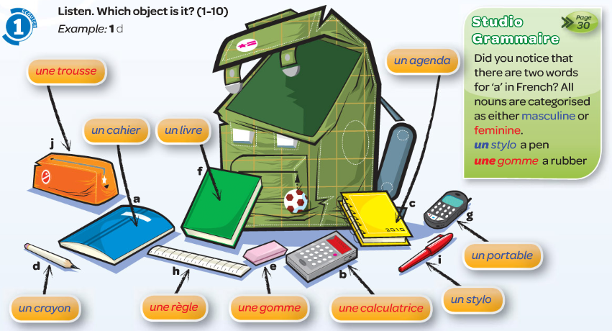
d) Draw the items in your book and label them in French.

Slide 5
e) Write sentences to describe each pencil case.
Dans ma trousse = in my pencil case
il y a = there is
un - one
deux - two
trois - three
quatre - four
cinq - five
six - six

Slide 6
f) Work out which pencil case item it is and write the answer in your book.

Slide 7
g) Which is the off one out and why?
1. The odd one out is une gomme because the other two words say un.

Slide 8
h) Write out the text, using words instead of the pictures.
bag - sac

